Slide 1
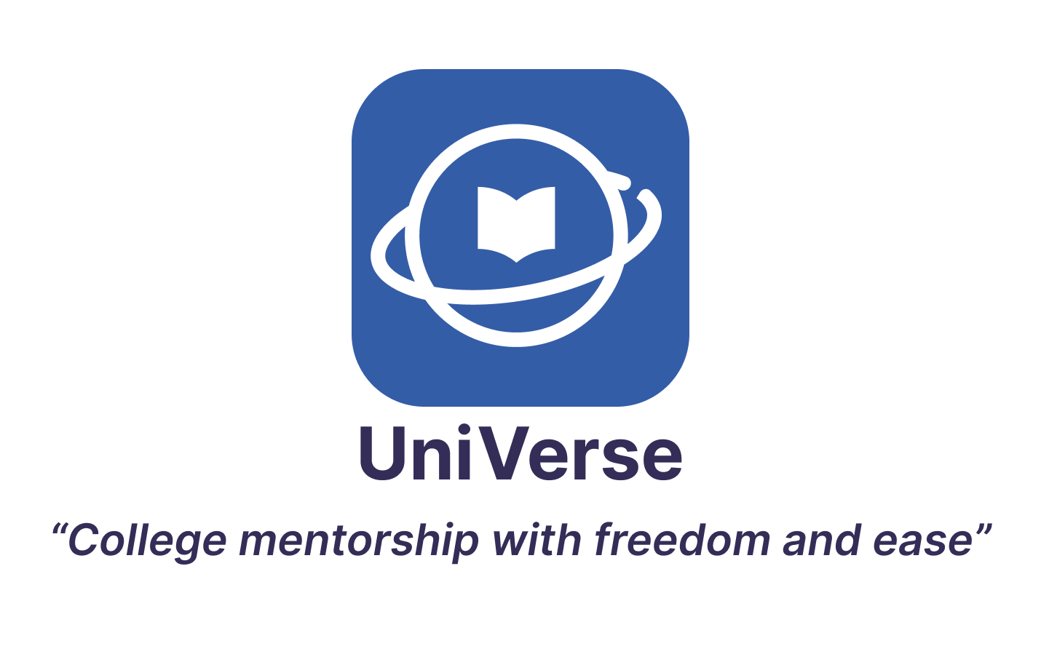

Slide 2
1
Title & value proposition
Table of contents
2
Problem/solution overview
3
Values in design
4
Tasks
5
Usability goals & key measurements
6
Revised interface sketches
7
Medium-fi task flows
8
Prototype implementation
9
Appendix/link to Figma

Slide 3


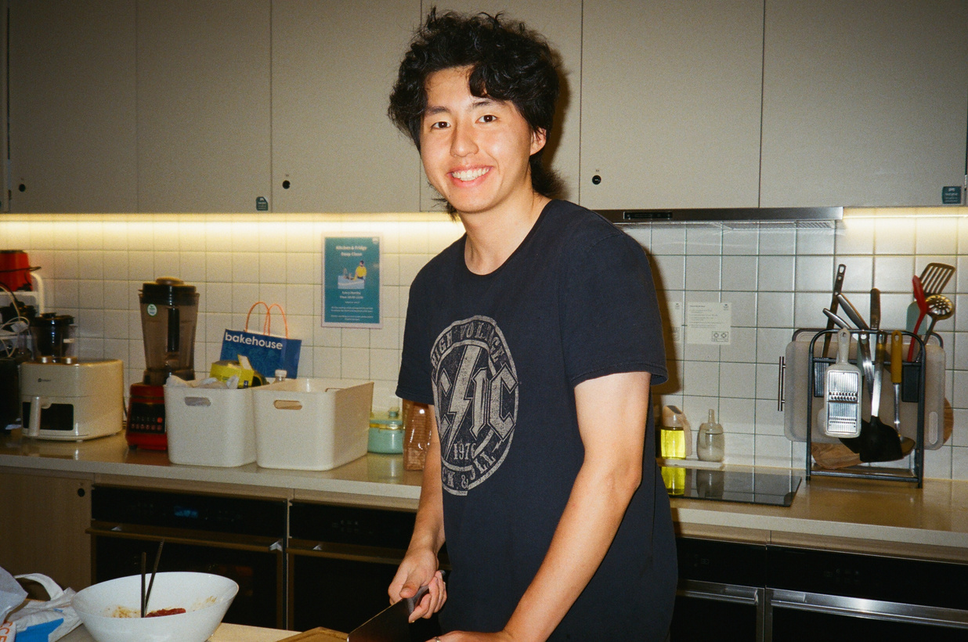

Meet the team
Sally
Steve
Zijian
Eric
Economics ‘25
Hong Kong
CS ‘25
California
Symsys ‘26
Chengdu, China
CS ‘24
California

Slide 4
Title & Value Proposition

Slide 5
Problem & solution
Problem you are tackling:
Counselors lack independence when choosing students they want to work with (and topics) as they often work under a centralized topic
Our Primary User:
College Counselors
Brief synopsis of your proposed solution:
An app to allow Counselors to choose to work with small groups of students with interests and backgrounds that cater to their own knowledge.

Slide 6
Values in design

Slide 7
Values
FREEDOM
Freedom
Give counselors a choice in what students they want to work with and subject areas to focus on
Ease
By providing accessible classroom tools that make it easy to track student progress and AI-generated insights, counselors’ work can be made more efficient
Community
Creating a space for counselors to build d long term relationships with different students, but also where students can find like-minded peers
EASE
COMMUNITY

Slide 8
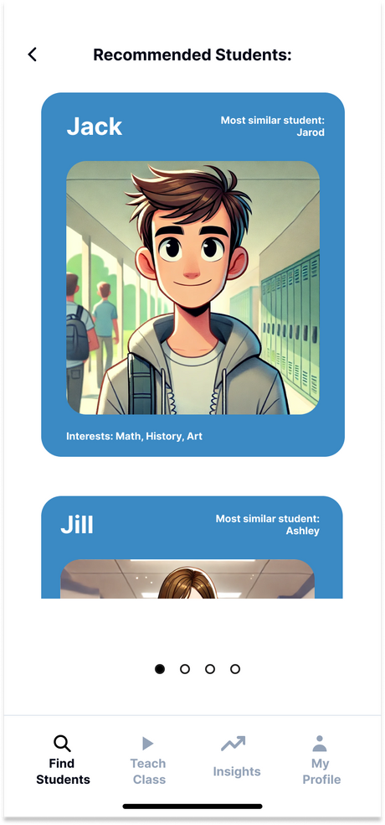
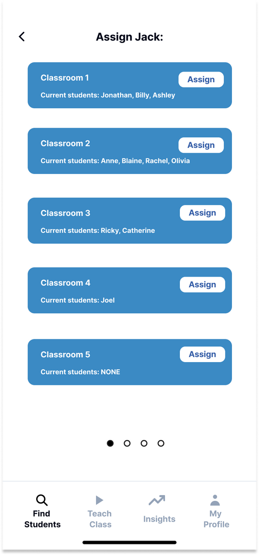
Freedom
In our Simple Task, we give counselors the choice of choosing students based on common backgrounds and interests
After selecting a student they want to work with, the counselor also gets the choice of adding the student to a particular classroom that focuses on an area of college applications
Counselor is active in this matching process

Slide 9
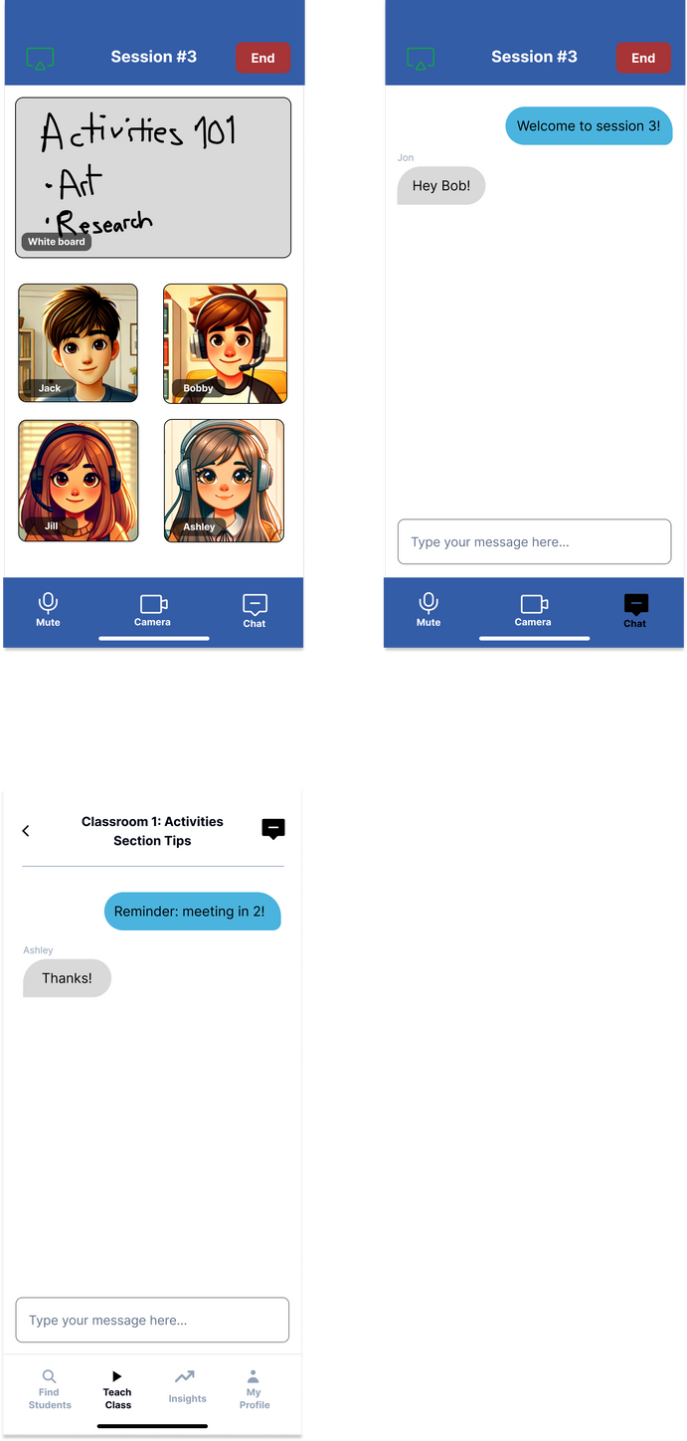
Ease
SYNC CHATROOM
In our Medium Task, we give counselors the tools to conduct classes both synchronously and asynchronously
To do this, we have the chatroom class functions both within a live session itself, but also a general chatroom that exists outside any sessions
ASYNC CHATROOM

Slide 10
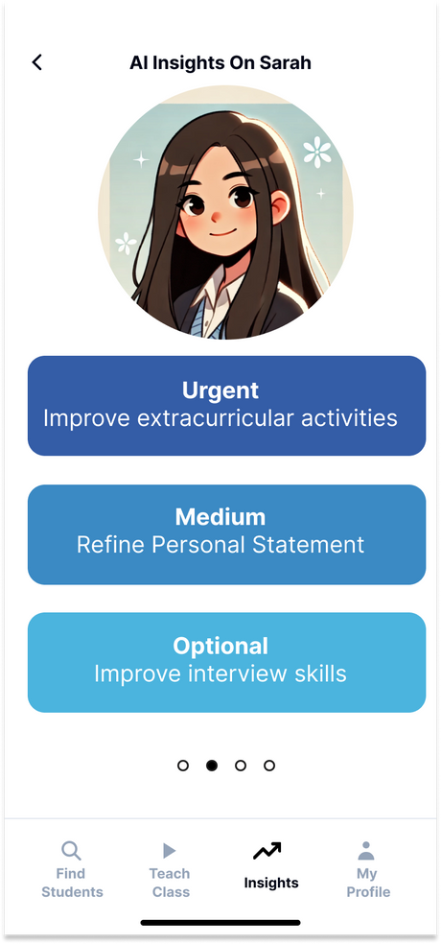
Ease
In our Complex Task, we leverage AI to provide real-time insights for counselors as well as actionable items for them to follow up with their students
This reduces counselors’ workloads, increases their efficiency, and potentially generates insights they would have missed or wouldn’t have thought of

Slide 11
Community
In our Simple & Medium Tasks, we allow counselors to add students they would like to work with to existing communities of students
This not only allows counselors to develop a long-term relationship with students, but allows students to form organic connections with each other since they already share similar interests and goals

Slide 12
Value Conflict: Freedom vs. Community
ON THE ONE HAND...
Giving counselors a say in who they want to work with might motivate them to teach more effectively and enjoy their work
ON THE OTHER HAND...
Giving counselors the choice to choose could also undermine a truly inclusive community, especially if certain counselors hold prior biases or stereotypes about certain groups of students they don’t wish to work with
SO..
While maintaining counselor freedom, we need to monitor for cases where a diverse and inclusive community is being undermined

Slide 13
Tasks

Slide 14
Tasks Before
SIMPLE
MEDIUM
COMPLEX
Find students who counselors want to work with
Teach students they want to with in an app-environment
Have AI-powered tools that make managing student data and progress easier

Slide 15
Tasks After
SIMPLE
MEDIUM
COMPLEX
Find students who counselors want to work with
Teach students in an app environment that facilitates sync/async class coordination
Have AI-powered tools that make generate insights on student progress and give actionable recommendations
No change - like the simplicity of the most accessible task
More specificity about what our particular app environment provides
Also includes how these insights are followed by actionable items, improving this function’s practicality

Slide 16
Usability goals & key measurements

Slide 17
Usability Goals & Key Measurements
GOAL # 1
GOAL #2
Intuitive
Want the UI to be easily understandable so that first-time users can enjoy it as well as power users
Helpful
Counselors find the app environment & tools useful and allows them to be more efficient than before
Key Measurement:
# of times user ask clarifying questions
# of times users press back button
Key Measurement:
Positive feedback users give from a counselor’s POV, especially regarding the quality/novelty of the app’s tools and features

Slide 18
Progress towards usability goals
GOAL # 1
GOAL #2
Intuitive
Want the UI to be easily understandable so that first-time users can enjoy it as well as power users
Helpful
Counselors find the app environment & tools useful, which allows them to be more efficient than before
Progress towards this goal:
Changed logic for simple task to make it more easily understandable after user and section feedback
Progress towards this goal:
Added new sub-feature for complex task to include actionable steps on top of AI-generated insights
Created chatting feature to allow for async collaboration

Slide 19
Planned steps to further progress
GOAL # 1
GOAL #2
Intuitive
Want the UI to be easily understandable so that first-time users can enjoy it as well as power users
Helpful
Counselors find the app environment & tools useful, which allows them to be more efficient than before
Further progress plans:
Wait for heuristic feedback and focus on comments on the app’s intuitiveness/UI
Implement these changes as necessary
Further progress plans:
Wait for heuristic feedback
Focus on comments relating to how our app enhances the work of counselors
Implement feedback as necessary
Further rounds of testing

Slide 20
Revised interface sketches

Slide 21
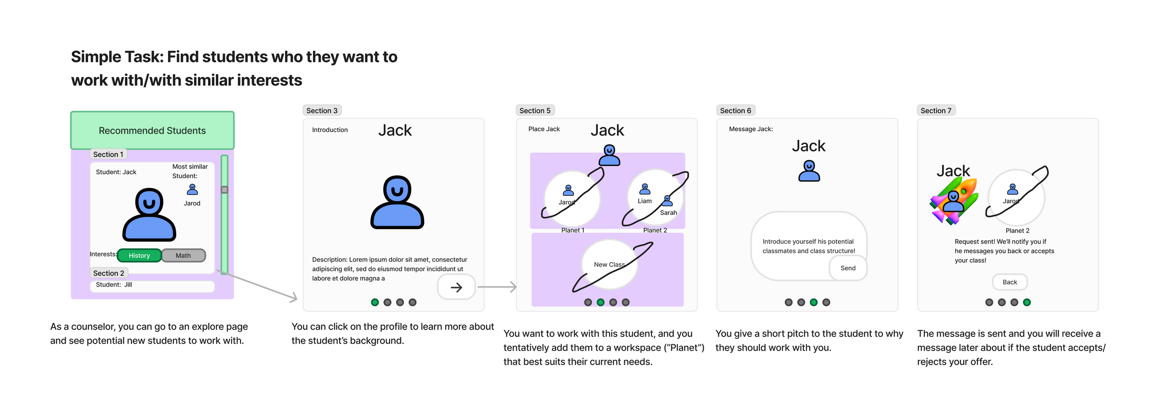
Major Change 1 - Corrected logic in simple task
Before
Counselors choose a student they are interested in and temporarily assign the student to a classroom
They would then wait for the student’s acceptance
Feedback
The simple task flow was not intuitive enough
In particular, people did not understand why students were assigned to classrooms even before they accepted the counselor’s invite

Slide 22
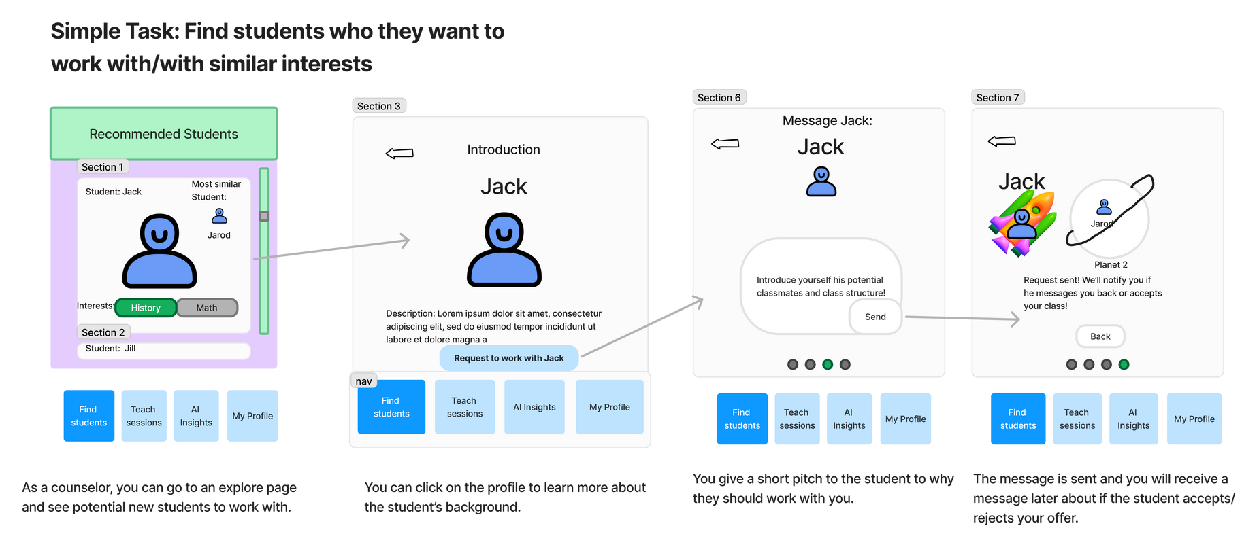
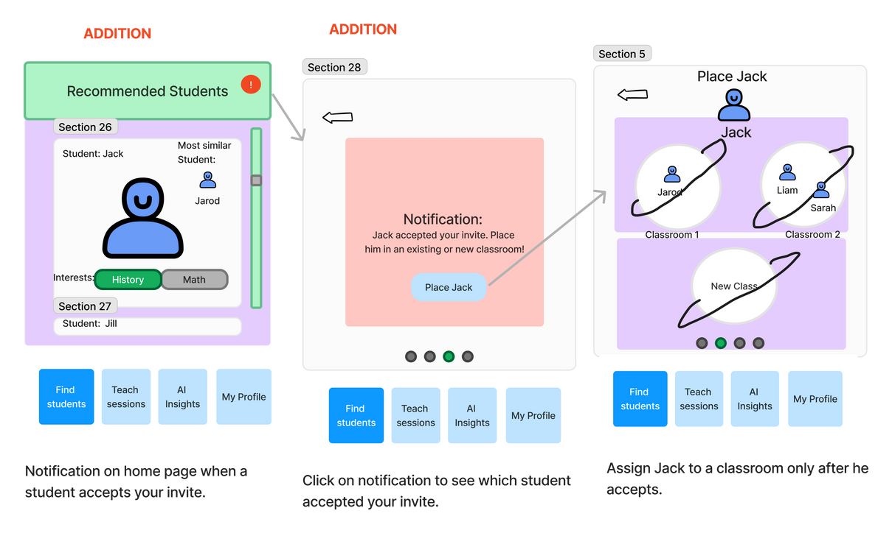
Major Change 1 - Corrected logic in simple task
After
Split the task into 2 parts
Counselors first send a request to a student they would like to work with
If a student accepts their request, the counselor is notified, and only then can they add the student to a classroom
How change addresses usability goals
Addresses concerns about how the original flow is unintuitive
The fact that counselors are only able to assign students after they accept is more aligned with how we think about requests/acceptance in real-life

Slide 23
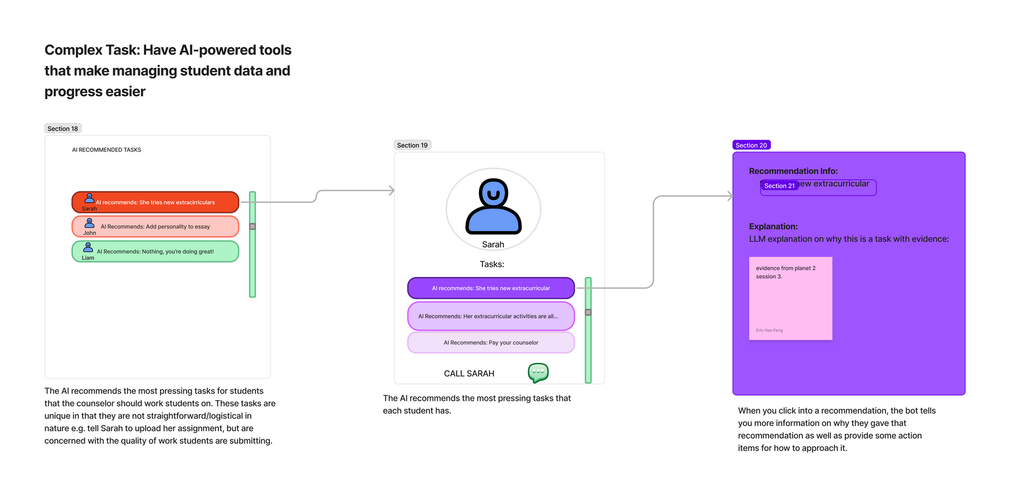
Major Change 2 - Actionable steps in complex task
Before
In the complex task, counselors can view AI-generated insights about how they can improve student performance
Feedback
Insights alone might not be novel and useful enough by themselves
It would be better if the insights were accompanied by actional items (“next steps”) that counselors can follow up with right away

Slide 24
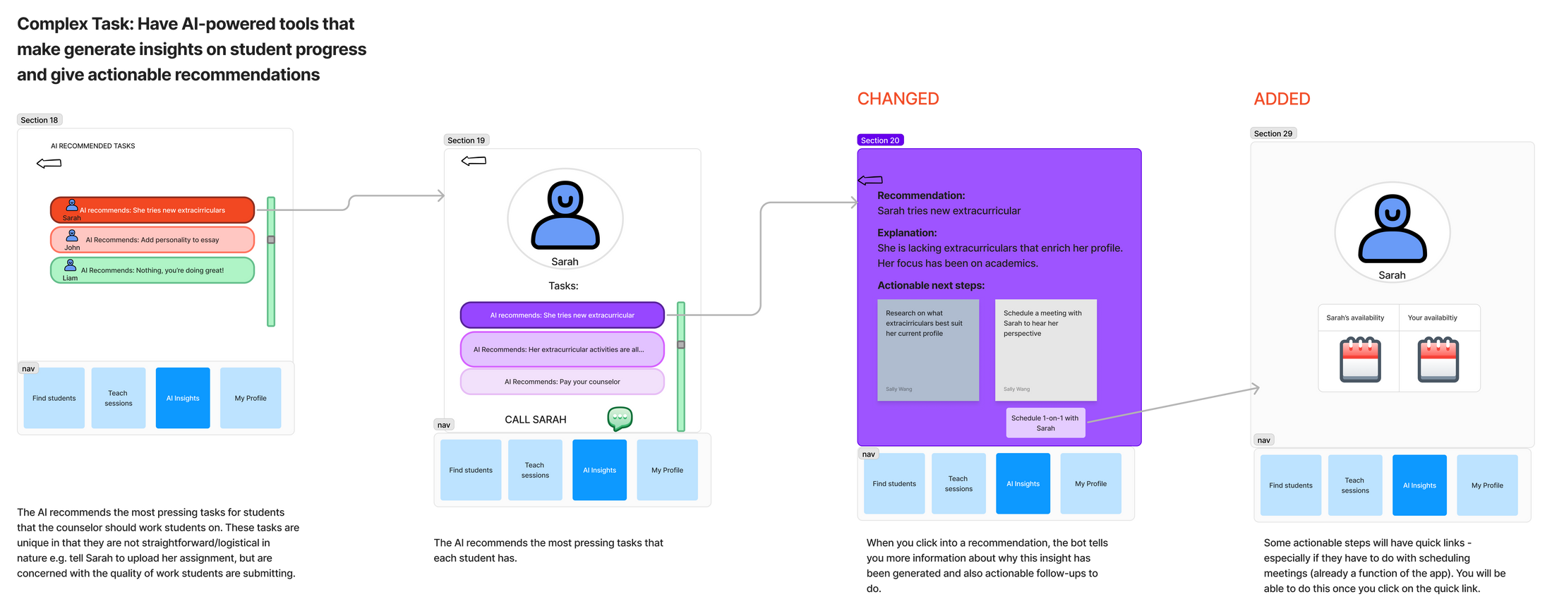
Major Change 2 - Actionable steps in complex task
After
For each recommendation, we provide actionable next steps on top of an explanation of the recommendation
How change addresses usability goals
This improves the “useful” usability goal as it gives the counselors concrete steps to take in order to improve the student’s performance
By including quick-links for some next steps that can be done within the app e.g. schedule 1-on-1 meetings, the user experience is improved further

Slide 25
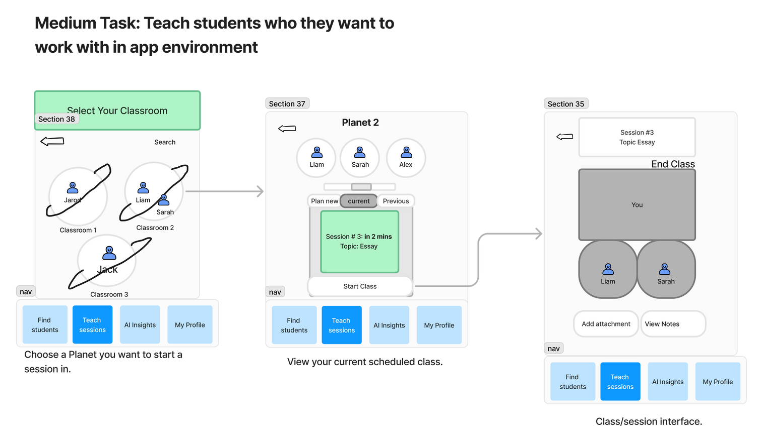
Major Change 3 - Creating an Async Collaboration Method
Before
Counselors would wait until a scheduled meeting to work with their students.
Students would share all updates and questions during scheduled live sessions.
Feedback
Testers felt like they were limited to only short meeting times to work with their students.
It would be overwhelming to try to answer everyone’s questions or provide resources if everything had to happen live.
Users expressed needs of assisting students who wouldn’t be able to join meetings with microphone and camera access.
Note: only the selected portion of the moderate task relevant to this major change is shown here due to the large size of the task.

Slide 26
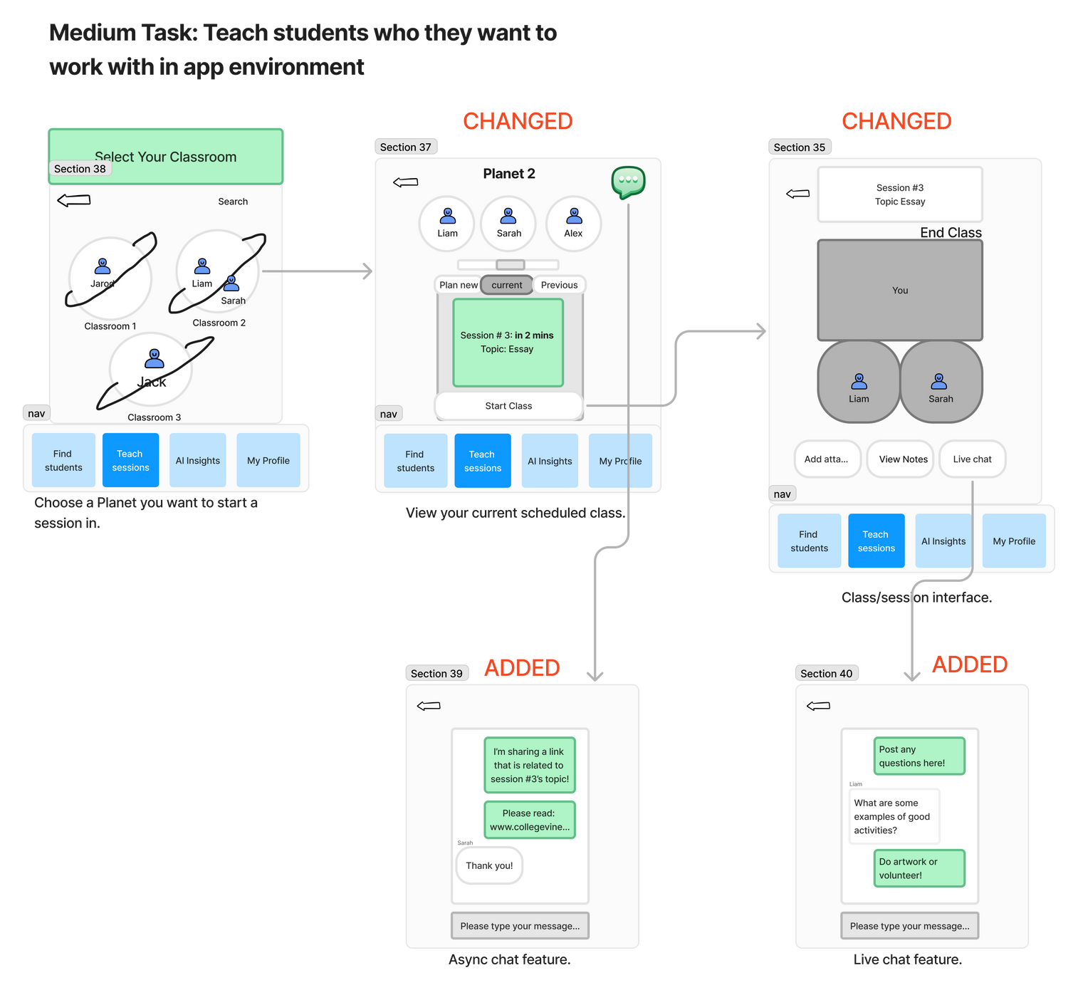
Major Change 3 - Creating an Async Collaboration Method
After
We decided to add two places where counselors could chat with their students: one in the classroom interface and one during live meetings.
How change addresses usability goals
The ability for counselors to chat with their students beforehand addresses our helpfulness goal since it allows counselors to communicate in an asynchronous manner.
This new feature is also intuitive because it would exist in almost all frames of the moderate task, making it clear and easily accessible.
Note: only the selected portion of the moderate task relevant to this major change is shown here due to the large size of the task.

Slide 27
Medium-fi task flows

Slide 28
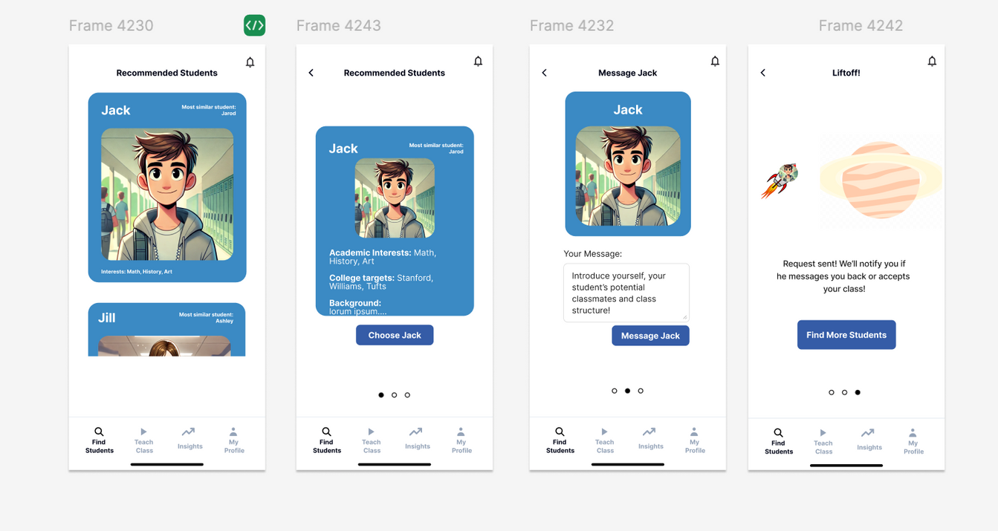
SIMPLE
Find students who counselors want to work with
Back
Back
Back
PRESS JACK PROFILE
PRESS CHOOSE JACK
PRESS
MESSAGE JACK
STEP 1:
CHOOSE
STUDENT
STEP 2:
READING ABOUT STUDENT
STEP 3:
PITCH TO
STUDENT
STEP 4:
SEND REQUEST

Slide 29
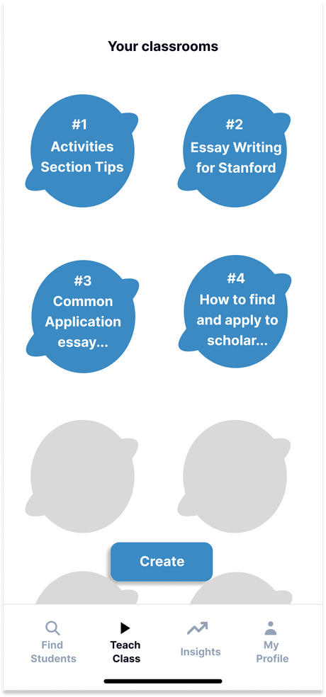
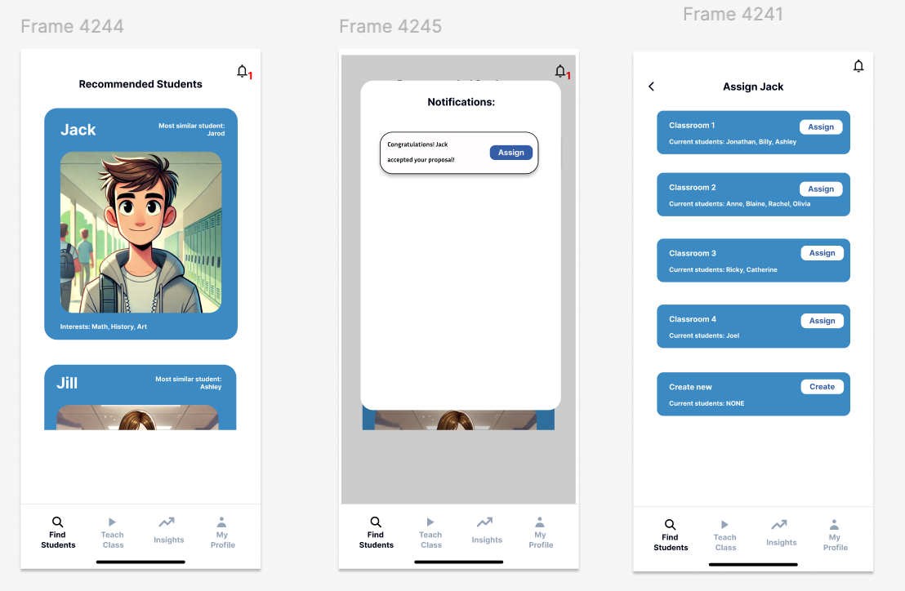
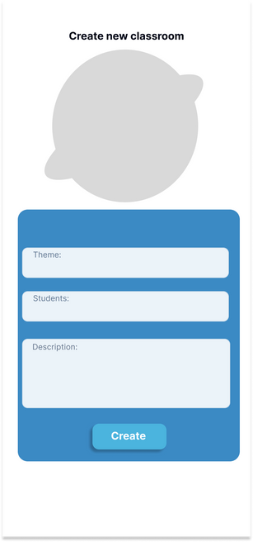
SIMPLE
Find students who counselors want to work with (P2 when Student Accepts)
BACK BUTTON
PRESS ASSIGN
STEP 4A:
CLASSROOMS VIEW
(MORE DETAIL IN MEDIUM TASK)
PRESS BELL
BACK BUTTON
PRESS ASSIGN
PRESS CREATE
STEP 4B:
CREATE NEW CLASSROOM
STEP 1:
NOTIFICATION APPEARS
STEP 2:
SEE WHICH
STUDENT
ACCEPTED
STEP 3:
ADD STUDENT TO
CLASS OR MAKE
NEW CLASS

Slide 30
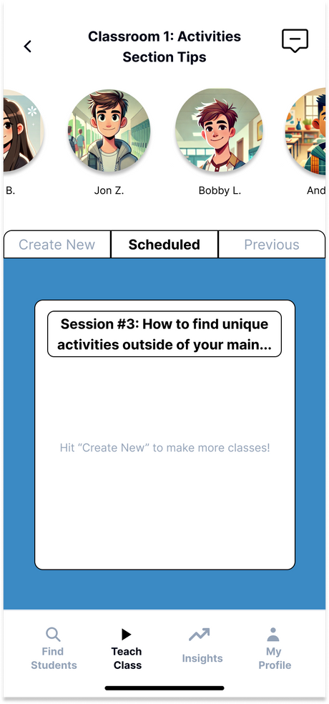
MODERATE
Back
Create and navigate the classroom environment
Press class #1
Part 1:“Scheduled” tab flow
Part 2: “Previous” tab flow
Part 3: “Create New” tab flow
Part 4:“Chat” flow
START:
PICK YOUR CLASSROOM

Slide 31
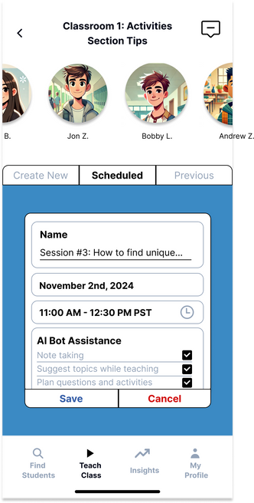
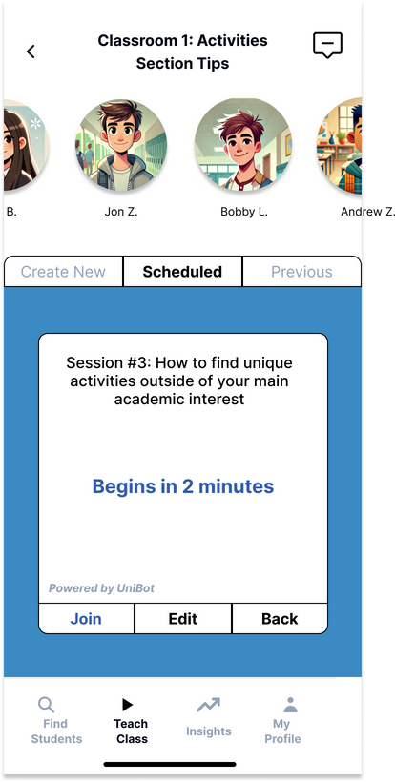
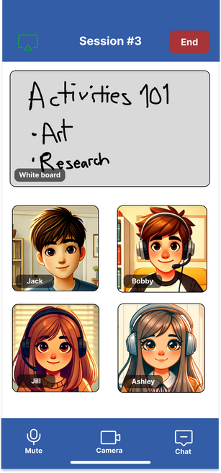
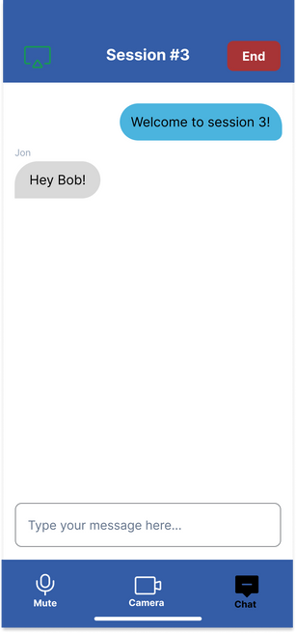
MODERATE
Part 1:“Scheduled” tab flow
Back
Back
Press Edit
STEP 2: EDIT YOUR CLASS INFO
Leave call
Press Session #3
Press Chat
Press Join
START:
PICK YOUR CLASSROOM
STEP 1:
SELECT YOUR SCHEDULED CLASS
STEP 3: JOIN CLASS MEETING
STEP 4: CHAT LIVE WITH STUDENTS

Slide 32
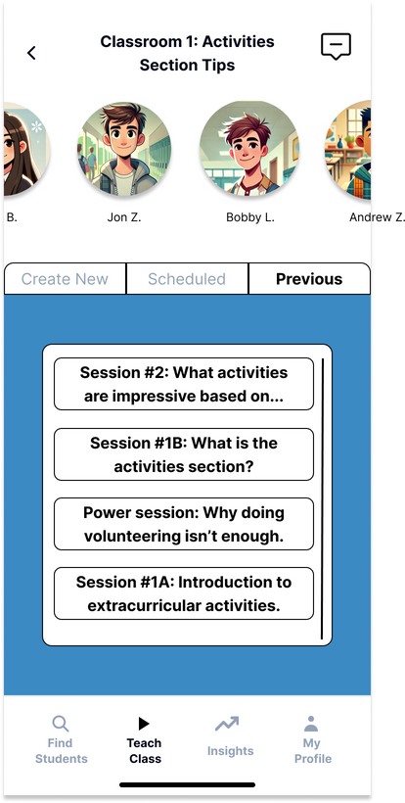
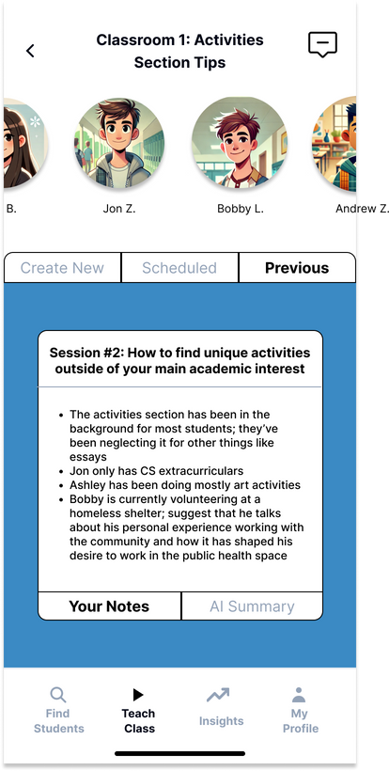
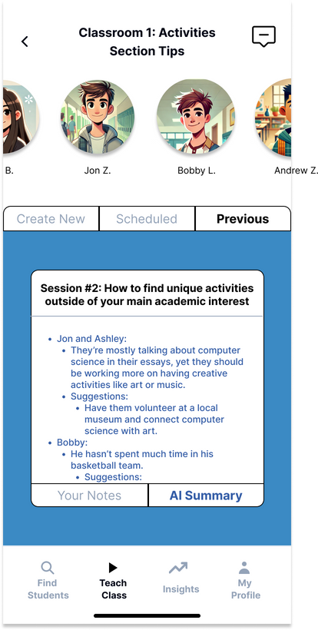
MODERATE
Part 2:“Previous” tab flow
Back
Back
Back
Press Previous
Press AI Summary
Press Session #2
START:
PICK YOUR CLASSROOM
STEP 1:
LOOK THROUGH PREVIOUS LESSONS
STEP 2:
READ THROUGH YOUR NOTES
STEP 3:
READ THROUGH AI BOT’S NOTES

Slide 33
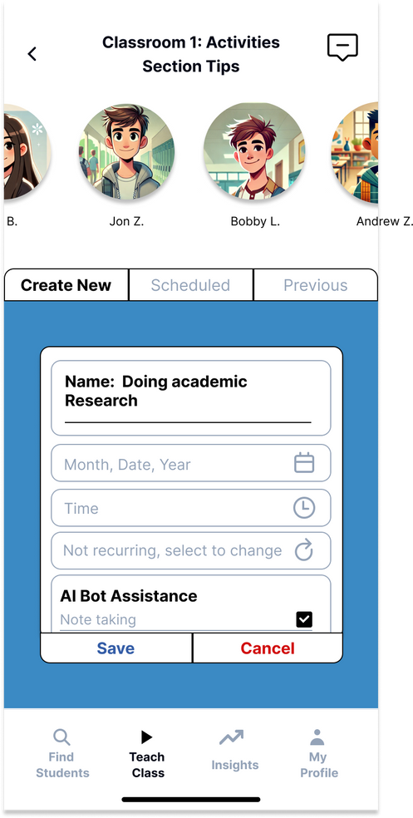
MODERATE
Part 3:“Create New” tab flow
Back
Press Create New
START:
PICK YOUR CLASSROOM
STEP 1:
CREATE A NEW LESSON

Slide 34
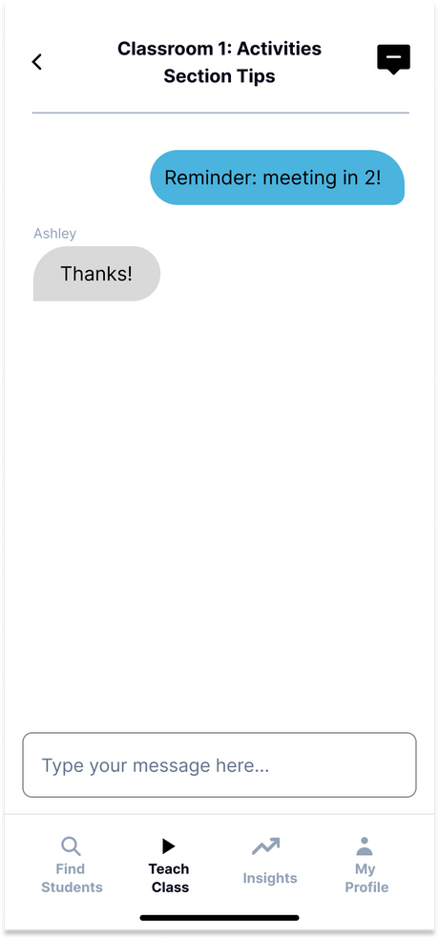
MODERATE
Part 4:“Chat” tab flow
Back
Press Chat icon
START:
PICK YOUR CLASSROOM
STEP 1:
OPEN AND INTERACT WITH STUDENT ASYNC

Slide 35
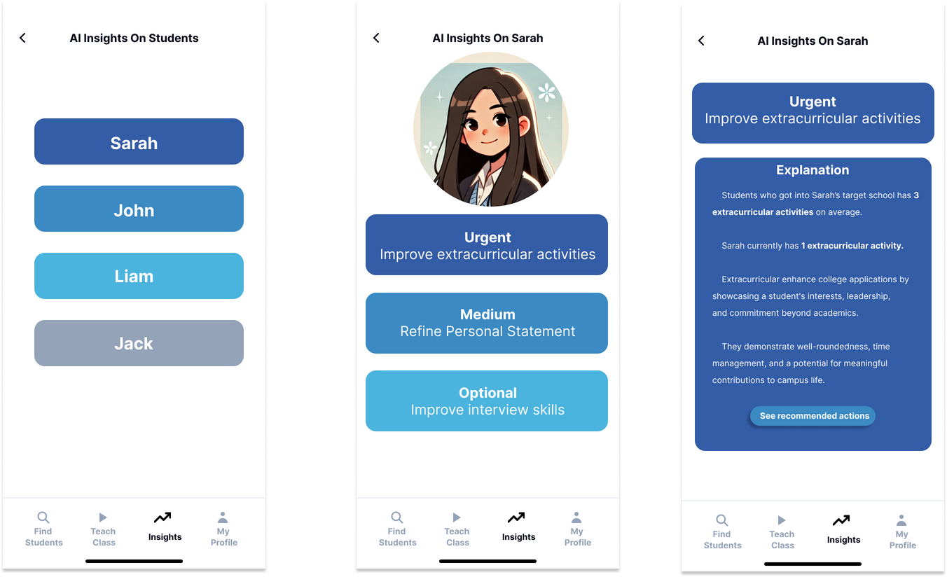
COMPLEX
AI insights and recommendations
Back
Back
Press one of the insights.
Press student name
STEP 1:
CHOOSE
STUDENT
STEP 2:
CHOOSE
ONE OF
THE INSIGHTS
STEP 3:
GET THE DETAILED
EXPLANATIONS

Slide 36
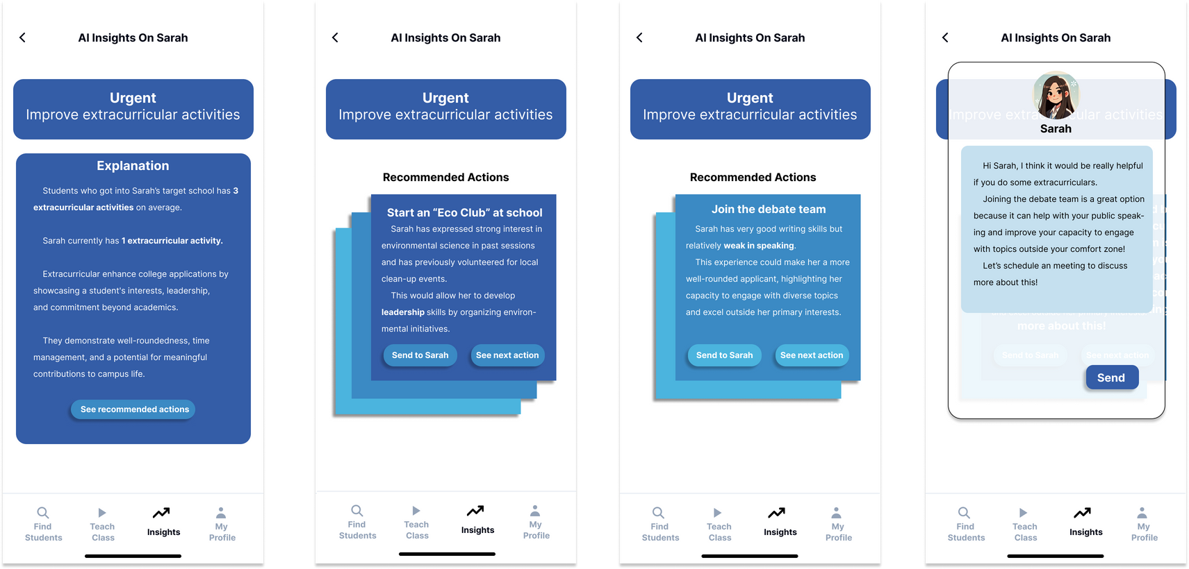
COMPLEX
AI insights and recommendations
Back
Back
Back
Press send to students
Press see actions
Press see next actions
STEP 3:
GET THE DETAILED
EXPLANATIONS
STEP 4:
SEE RECOMMENDED ACTIONS
STEP 5:
SEE MORE RECOMMENDATIONS
STEP 6:
SUGGEST TO STUDENTS

Slide 37
Prototype implementation

Slide 38

Prototyping Tools - GoodNotes
Pros
Cons
Lack visual design features, such as vector tools, component libraries, or reusable assets.
No collaboration features for real-time editing.
Limited support for platform-specific features, meaning we can’t use interactive mobile layouts.
Limited color, font, and icon options.
Simple to use and easy learning curve.
Convenient for collaboration, since you can share your notes or export designs quickly.
Ideation, low-fidelity sketching, and rapid iteration of early task flows
Great for drawing, sketching, and organizing ideas.

Slide 39
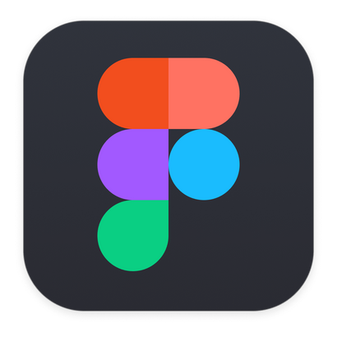
Prototyping Tools - Figma
Pros
Cons
Enables reusable components (such as buttons and icons) for consistency and building complex interfaces.
Plenty of free templates, artwork, and fonts to customize our vision.
Contains platform-specific tools to mimic the mobile app experience.
Steep learning curve when trying to design an app.
Complex logic that makes it difficult to fix errors and correct small issues, and can be overkill at times.
Limited video and audio capabilities.
Medium-fidelity prototyping and creating our mobile app screens

Slide 40

Prototyping Tools - ChatGPT
Pros
Cons
Cost and time efficient, reducing the need to draw scenes or find real people.
Consistent aesthetic across different generations, i.e. all students are created in a similar cartoonish style.
Creates diverse and inclusive artwork representing a wide variety of users.
Often misinterprets our requests even through repeated conversation.
Challenges with complex UI elements since the images are static and not easy to customize.
Generating artwork and photos of people

Slide 41
Limitations and Trade-offs
We can’t integrate real student and counselor information in our profile building process
We were limited by time and couldn’t build out the student’s POV of our tasks
Can’t simulate an actual class being run with real-time AI assistance
There are no video or audio components to demonstrate our video meeting features
We don’t have data from colleges, which would improve AI insights and student matching

Slide 42
Wizard of Oz Features
We simulated a student accepting our counselor’s request to work together, even though this isn’t guaranteed.
We added mock “previous” classes that the counselor completed to demonstrate the ability for them to re-visit lessons in our moderate task.
We created multiple classrooms and showed that our counselor is fairly active on our app, which also gives enough information for the AI insights to work with.

Slide 43
Hard Coded Items
Our counselor selected AI help to be active in our moderate task, allowing it to generate content for their classroom.
We created our own students and their profiles so the counselor would have people to match and work with.
All the “AI” insights and messages/notes written by the counselor are pieces of content we wrote to demonstrate functionality.

Slide 44
Appendix

Slide 45
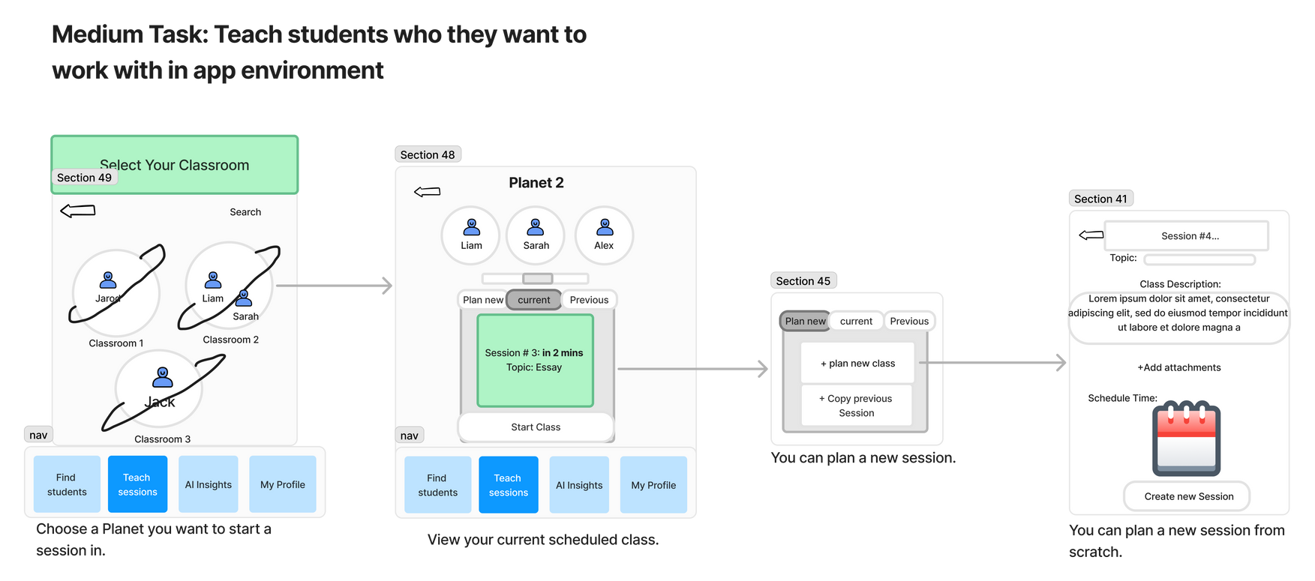
Major Change 4 - Scheduling multiple meetings
Before
Counselors could only create and access one upcoming meeting at a time.
Feedback
Testers voiced concerns that by only having one current scheduled meeting, it would give students too short of a notice to plan and prepare.
Users expressed the need of planning multiple meetings in advance, and possibly even making them recurring.
During studio, a peer was confused as to why there was only one session at a time when they would want to plan multiple.
Note: only the selected portion of the moderate task relevant to this major change is shown here due to the large size of the task.

Slide 46
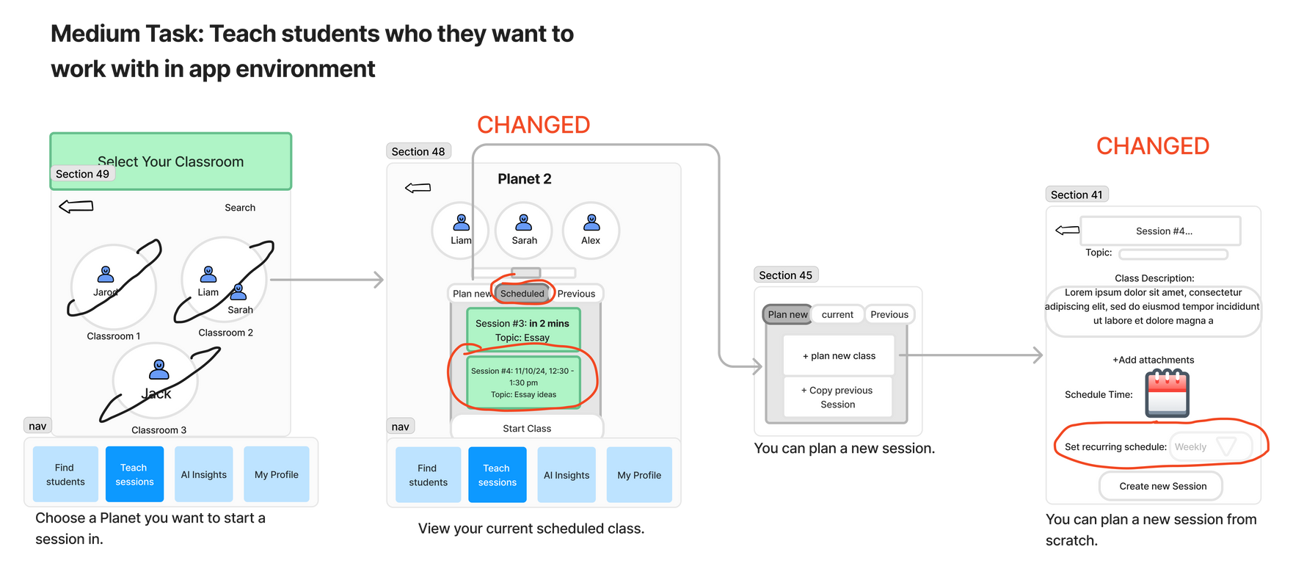
Major Change 4 - Scheduling multiple meetings
After
We decided to change our “Current” meeting tab to “Scheduled,” and added the ability for counselors to schedule as many meetings as they wanted.
All future meetings would be displayed in the “Scheduled” tab.
How change addresses usability goals
The new design is intuitive because when you clicked “New,” counselors would’ve expected to be able to schedule as many meetings as they want.
It didn’t make sense to have one scheduled meeting a time and be blocked from creating new ones.
This is also helpful because it gives counselors additional ways to plan their classrooms and work toward long-term success with students.
Note: only the selected portion of the moderate task relevant to this major change is shown here due to the large size of the task.

Slide 47
Figma Prototype Link
LINK

Slide 48
Figma Prototype Walkthrough
Overall Flow
Includes onboarding process (sign up/log in)
Can travel between different tasks
Three Task Flows

Slide 49
Website
LINK

